Slide 1

Beginning you Writing

Slide 2
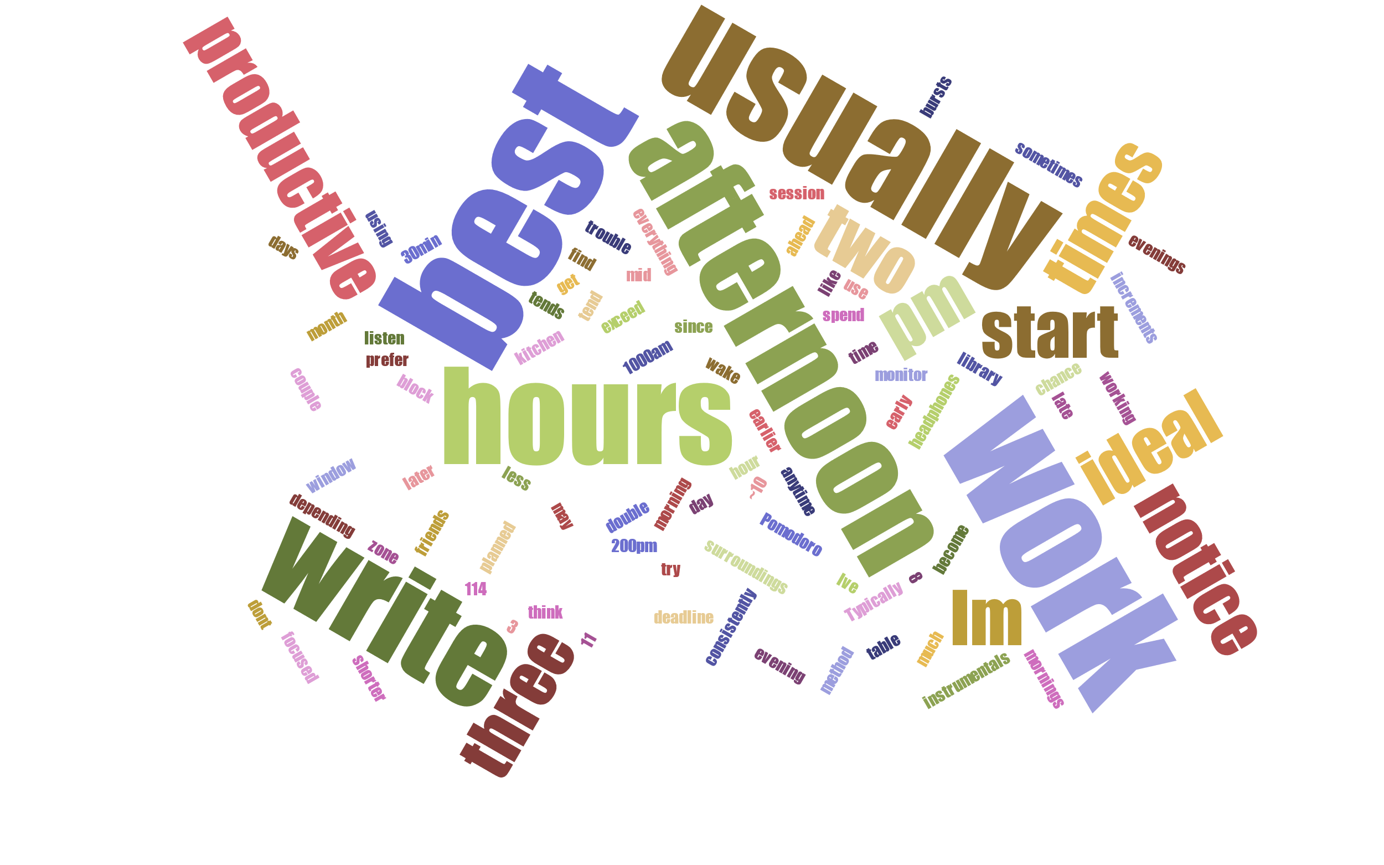
Time

Slide 3

Space

Slide 4

Metaphors
Stew/Marinate/Serve
Excavate/Polish
Plan/Sketch/Revise/Review
Carrot/Stick
Chaos/Quantum entanglement

Slide 5
Social Habits

Slide 6
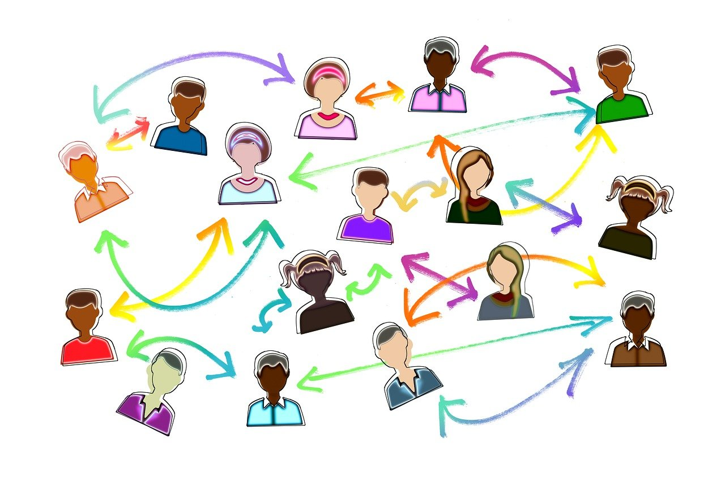

For, With, and Among
Writing FOR others
Writing WITH others
Writing AMONG others
Notes:
https://pixabay.com/illustrations/social-media-connections-networking-5481633/

Slide 7
When we write for others, we engage in conversation with our readers. When we write with others, we work with colleagues toward a common product when we write among others, we create a community of writers.
Helen Sword, author of Air & Light & Time & Space: How Successful Academics Write

Slide 8

Results

Slide 9
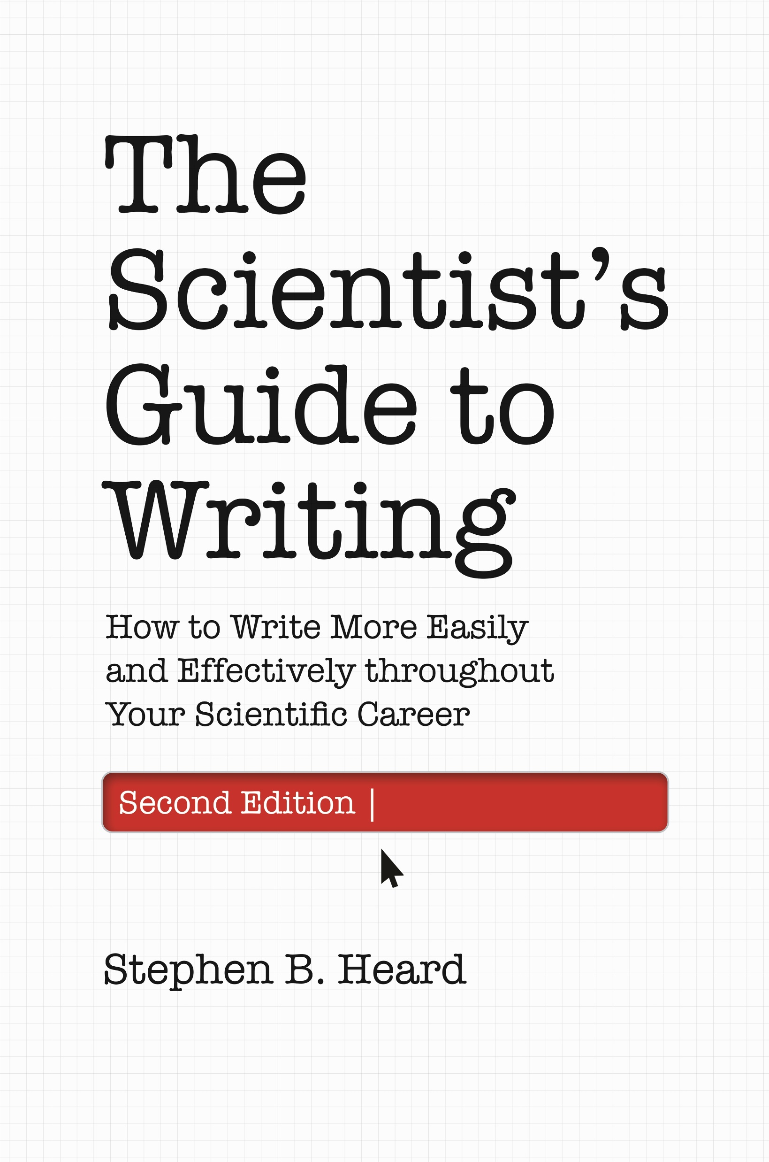


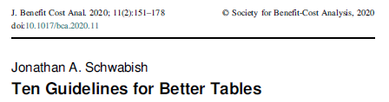

Sources and Inspiration
Stephen Heard, UNB, author of The Scientist Guide to Writing
Irving H. Zucker, UNMC
& Myron Toews, UNMC

Slide 10
Why
Tell people what you found through your research
Introduction – Why
Methods – How
Results – What happened

Slide 11

What
What’s the main thing you want the reader to learn?
What’s the major result that establishes this thing?
What other results are needed to support or qualify the major one?

Slide 12
Show only the data the reader needs to understand and accept the answer you’re presenting to your central research question.
-Stephen Heard, The Scientist’s Guide to Writing

Slide 13
How
Main result first
Exceptions:
Several lines of analysis
Very complex
Built of many pieces
Hybrid:
“ ‘Our analyses, taken together, show that only a moderate fraction of protostars occur in tight clusters…’ before backing up to present the separate results.” –Stephen Heard, The Scientist’s Guide to Writing

Slide 14
Where
Results text
Figures
Tables
IMRaD – After Methods
Combined with Discussion
Online supplements
Figure legends
Specifics for individual figures

Slide 15
The goal is to convey the greatest amount of information in the clearest fashion.
Paraphrase from Franzblau & Chung, 2012

Slide 16
How: Big Picture
All Result elements must be self-contained.
Text makes sense without graphics
Graphics make sense without text
BUT…Text and graphics also must work together
Notes:
https://www.ncbi.nlm.nih.gov/pmc/articles/PMC4008059/

Slide 17
Where
Text
Table
“Golden-mantled tree-kangaroo home ranges were on average 1.7 km² (± 0.9 SD), while Lumholtz’s tree-kangaroos had home ranges of 3.3 km² (± 1.8), Bennett’s tree-kangaroos 1.6 km² (± 0.7), and grizzled tree-kangaroos 2.2 km² (± 1.1)”.
Species | Home range size (mean) | SD
Golden-mantled | 1.7 | 0.9
Lumholtz’s | 3.3 | 1.8
Bennett’s | 1.6 | 0.7
Grizzled | 2.2 | 1.1

Slide 18
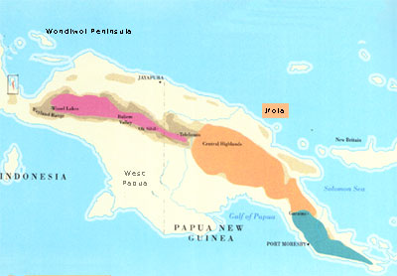

Where
Graph
Figure
Notes:
https://tenkile.com/ifola-tree-kangaroo/

Slide 19
Where: Text
Pros:
Low costs of navigation
Cons:
High costs of comprehension (for complicated items or imagery)
Considerations
Report only reasonable levels of precision

Slide 20
Where: Table
Pros:
Summarize points and reduce word count
Easy to extract precise numerical values
Cons:
Readers must navigate to, from, and within the table
Difficult to show trends, relationships among variables, etc.
Considerations:
Patterns are easiest to see vertically
Left-to-right convention (independent/dependent variables, etc.)
Use boarders and whitespace

Slide 21
Where: Figure/Graph
Pros:
Visual representation can be clearer
Easy to show trends, relationships among variables, etc.
Cons:
Readers must navigate to, from, and within the figure
Difficult to extract precise information
Considerations:
Too complicated distracts from the message
Accessibility (color-blind, using screen readers)

Slide 22
Graphics: Titles
Include:
Subject
Measurement
Treatment (if applicable)
Declare result
Salt reduces the growth of wheat plants
Not declare result
Height of wheat plants after salt treatment
Notes:
https://www.scienceeditingexperts.com/blog/creating-tables-in-scientific-papers-basic-formatting-and-title

Slide 23
Figures

Slide 24
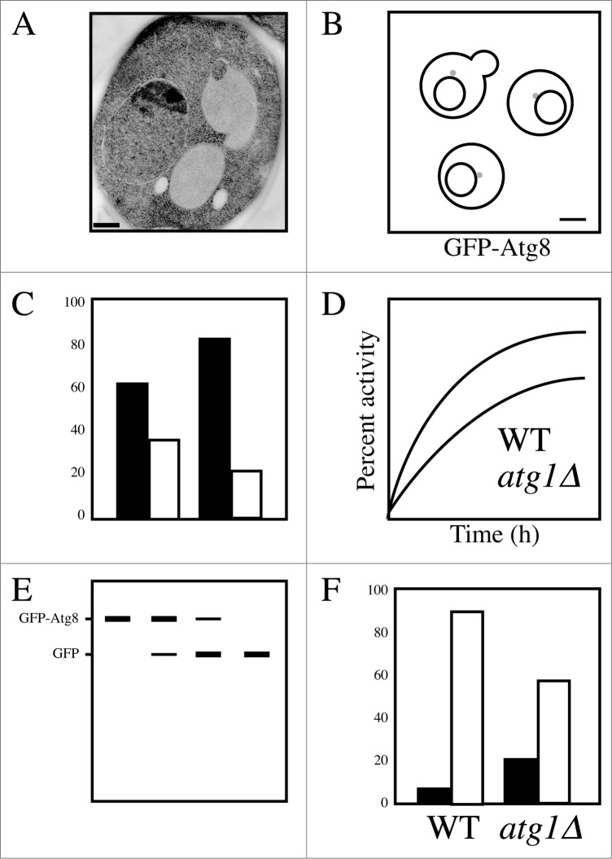
Figures: Basics
Appropriate resolution
Labels
Consistency
Clarity
Titles go in the figure legend
All symbols and font characters should be 1 mm tall on final figure size

Slide 25
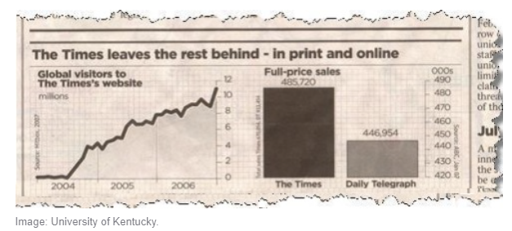
Figure: How NOT to
Misleading graphics
Graphics that fail to make a point
Confusing graphics
Poor design elements
Graphics that aren't visually appealing

Slide 26
How: Color
Color
Black and White
Easy to distinguish conditions
Free in online-only journals
Costly in print journals
Necessary for some figures
Never costly
Color-blind accessible
Can be difficult to distinguish conditions

Slide 27
Graphs

Slide 28
Figures: Data types
Qualitative (Categorical)
Sorted by category, not by number
Quantitative (Numerical)
Expressed numerically, not by category
Data Types
Qualitative
Nominal
Ordinal
Quantitative
Discrete
Continuous
Notes:
https://www.mygreatlearning.com/blog/types-of-data/

Slide 29
Figures: Data types
Nominal
No order
E.g., Hair color, Nationality, Gender
Ordinal
Natural or Intrinsic ordering or scale
E.g., Letter grades, Ranking in competition, Education Level
Data Types
Qualitative
Nominal
Ordinal

Slide 30
Figures: Data types
Discreet
Countable but finite
E.g., Number of students, days in week
Continuous
Fractional numbers
E.g., Height, speed, time
Data Types
Quantitative
Discrete
Continuous

Slide 31
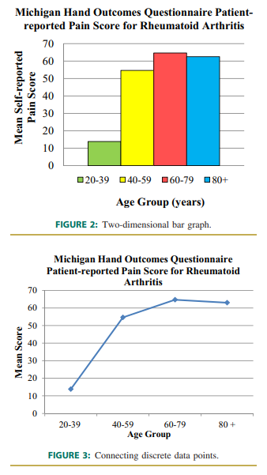
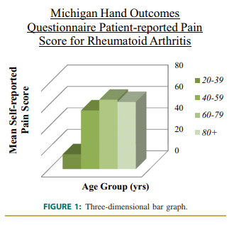
How: Graphs
Bar charts
For comparing categorical data or from 1 or multiple groups.
Line Charts
To depict how a single variable changes over a continuous variable
Notes:
https://towardsdatascience.com/data-visualization-101-how-to-choose-a-chart-type-9b8830e558d6

Slide 32
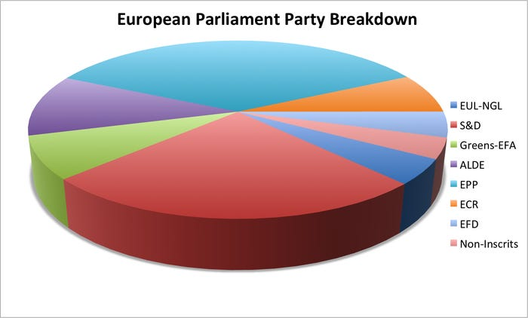
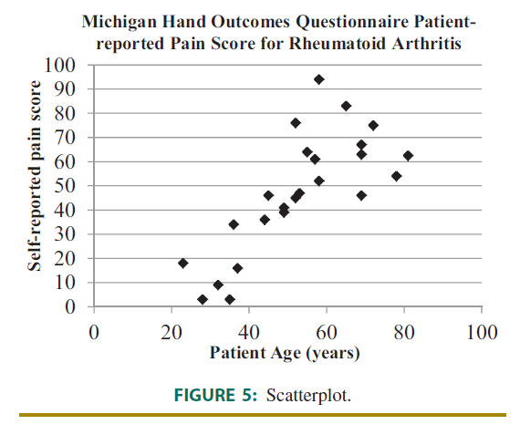
How: Graphs
Pie chart
Proportion or percentages of a dataset
Scatter plot
Show individual data points from bivariate data
Notes:
https://towardsdatascience.com/data-visualization-101-how-to-choose-a-chart-type-9b8830e558d6
https://www.businessinsider.com/pie-charts-are-the-worst-2013-6

Slide 33
How: Graphs
How important are the X-axis/Y-axis values?
What are you emphasizing?
One-, two-, or three-column?

Slide 34
Tables

Slide 35
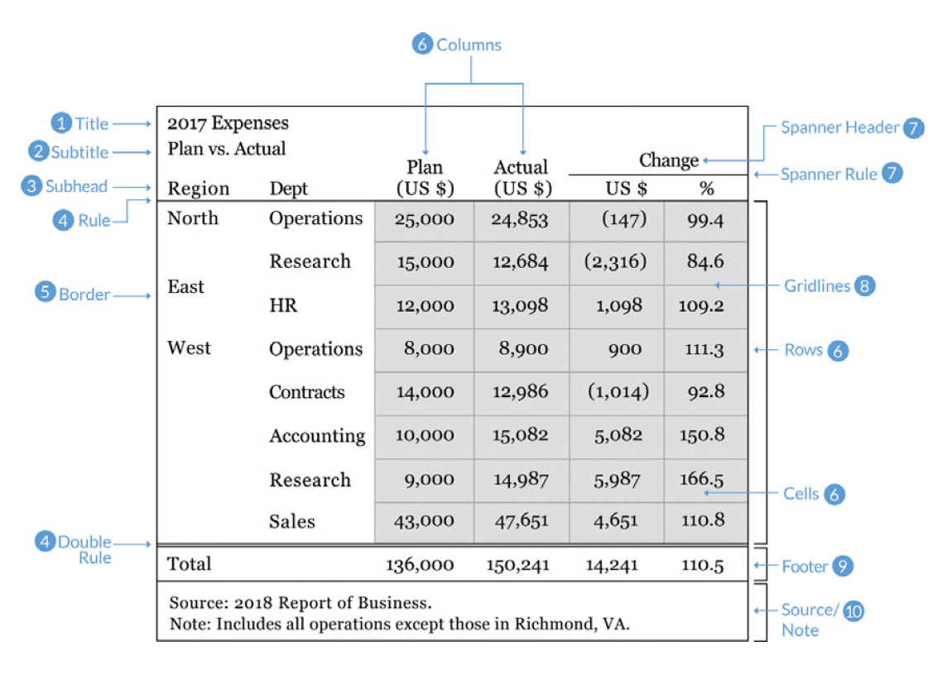
How: Table Basics
Column/Row titles
Use Excel or table feature
One cell = one data point

Slide 36
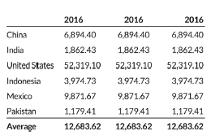
Tables: Formatting
Right-align your numbers
Left-align your texts
Use decimals appropriately (one or two is often enough)
Display units (e.g., $, %) sparsely (e.g., in column header or first row)
Notes:
https://www.r-bloggers.com/2020/09/10-guidelines-to-better-table-design/

Slide 37
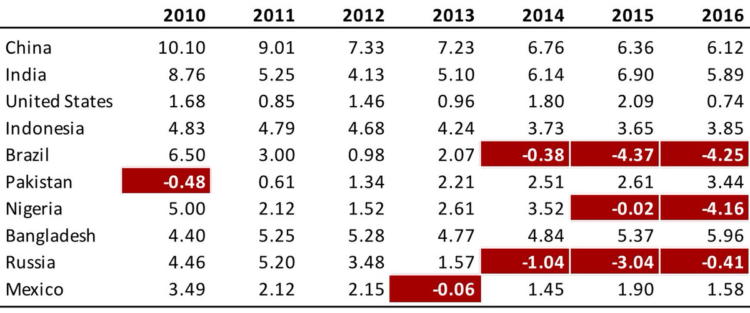
Tables: Tips
Highlight outliers
Highlight column headers
Use subtle highlights and dividers
Notes:
https://www.r-bloggers.com/2020/09/10-guidelines-to-better-table-design/

Slide 38
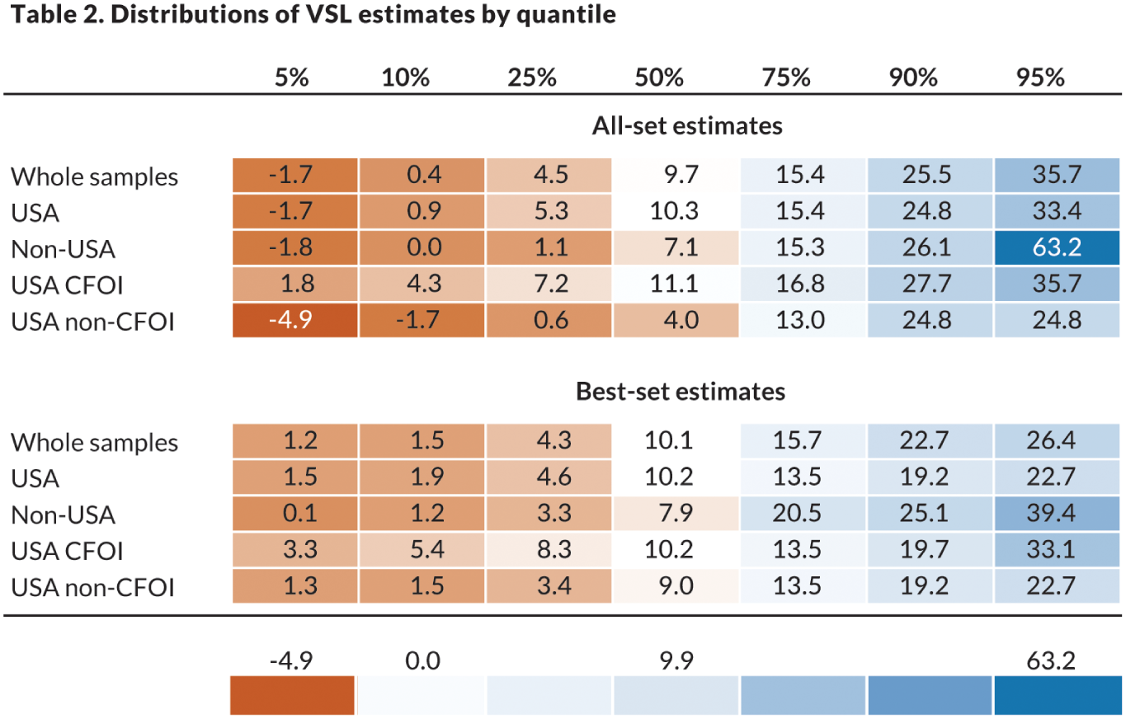
Table: Mashup
Add visualizations
Heat maps
Up/Down Arrows
Sparklines

Slide 39
Tables: Considerations
Too much/Too little data
Easiest to see trends vertically

Slide 40
Results Text

Slide 41
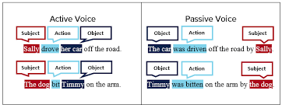

How
Past tense
Active voice
?!? First person !?!
Notes:
https://7esl.com/passive-voice/

Slide 42
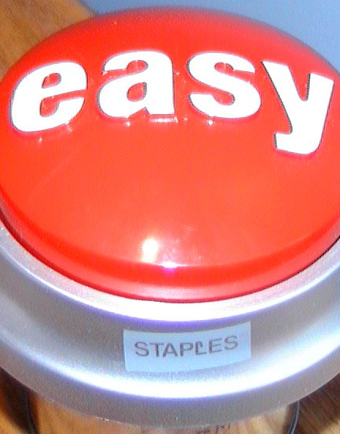

How
Make it easy for your readers!
Bold figure/table references in text
Keep figures/tables on same page as mentioned
Consistency, Fig or Figure
Notes:
https://commons.wikimedia.org/wiki/File:Easy_button.JPG

Slide 43
Results: Tips
Highlight contrasts/comparisons
Plants grew 50% faster…
Participants were more likely to choose A
Save interpretation for the Discussion
This is why its important or meaningful, or how it relates to other work

Slide 44
Workshop: Figure/Table Draft
Sketch out any figures and tables you think you need for your paper
Create titles
Add labels and comments
Consider the best organization of your figures and tables
Are they self-contained? If not, what do you need to add?

Slide 45
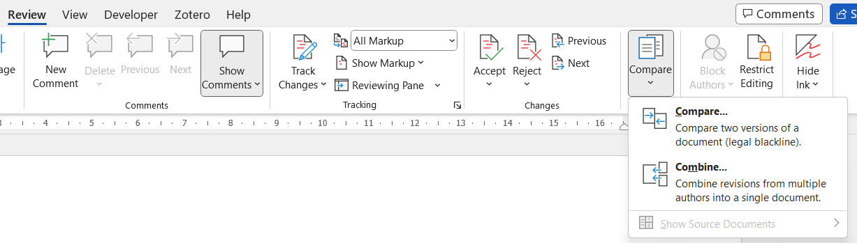

Responding to Peer Reviews
Click Review > Compare > Combine.
The Combine command on the Compare menu
In the Label unmarked changes with box, type a name or phrase so you’ll know who suggested the changes.
Click More to get more options for combining the documents﻿.
Show changes in new document
Word opens a new document that combines the original document and the copy you merged with it. The screen is divided into three sections. One section shows the Revisions made, the middle section﻿ shows the combined document, and the third section, which is split in two, displays the Original document and Revised document.

Slide 46
Small Group: Game
Active/Passive Voice
Figure/Table Criticisms
If active voice convert to passive, and reverse.
Make any other updates to clarify and shorten sentence
Right answers: 5 points
Wrong answers: 0 points
First right answer: +2 points
Each issue identified: 2 points
First group to finish: 2 points

Slide 47

Let’s Practice! Active vs Passive
After completion, as a group, rewrite each sentence in the opposite voice.

Slide 48

Figure Analysis

Slide 49
Assignment – Due 6/27
Writing
Reviewing
Title
Abstract
Results
Figures
Tables
Peer Group Methods

